Slide 1
SECURE DATA HIDING IN IMAGES USING STEGANOGRAPHY
CAPSTONE PROJECT
Presented By: Manoj B M
Student Name : Manoj B M
College Name & Department : Malnad College of Engineering, Hassan, Electronics and Communication Engineering.

Slide 2
OUTLINE
Problem Statement
Technology used
Wow factor
End users
Result
Conclusion
Git-hub Link
Future scope

Slide 3
Problem Statement
In today's digital era, securing sensitive information is crucial. Traditional encryption methods often raise suspicion, while steganography offers a more subtle approach. This project focuses on hiding secret messages inside images, making them undetectable by the naked eye. The goal is to securely embed and retrieve hidden data using image pixel manipulation.

Slide 4
Technology used
Programming Language: Python
Libraries: OpenCV, OS
Platform: Windows

Slide 5
Wow factors
Invisible Communication: The message is embedded into image pixels without visibly altering the image, ensuring discreet data transfer.Real-time URL analysis with GUI interface
Password Protection: Added layer of security with passcode-based decryption.
Simplicity & Efficiency: Lightweight and effective solution for data concealment.
Real-time Encryption & Decryption: Instantly hides and retrieves messages from images.

Slide 6
End users
Cybersecurity Enthusiasts: For secure communication.
Forensic Experts: To conceal sensitive data during investigations.
Developers & Researchers: Exploring steganography techniques.
General Users: For personal data protection.

Slide 7
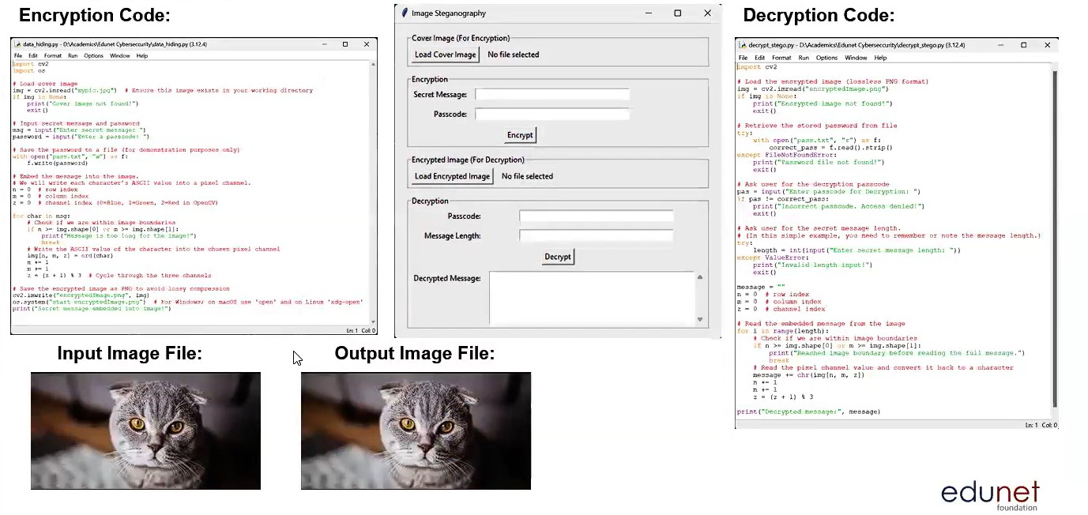
Results
GUI:

Slide 8
Conclusion
The project successfully demonstrates how steganography can be used to conceal sensitive information within images. By incorporating password protection, it enhances the security of the hidden message. This technique provides a discreet and reliable method for secure data transmission.

Slide 9
GitHub Link
https://github.com/manojbm1612/steno_aicte.git

Slide 10
Multiple File Support: Extend the project to hide larger files or multiple messages.
Advanced Encryption: Add more complex encryption algorithms for enhanced security.
GUI Integration: Develop a user-friendly interface for better usability.
Cross-Platform Compatibility: Make the project compatible with Linux and MacOS.
Future scope

Slide 11
THANK YOU

